Slide 1
Multivariate Time Series Forecasting: Evaluating Bitcoin Predictions in Isolation and in Combination with Other Major Cryptocurrencies
Team:
Aravind Teja Chikoti
Sai Teja Devalla

Slide 2




Objective
Predicting Bitcoin returns (Target) for a period of 15 minutes from the "present” in isolation and with combination of Ethereum & Cardano.
Approach
Data Preprocessing
Filling Null Values
Filling Gaps
Log Transformation
Feature engineering
Data Partition
Comparison
Conclusion
EDA Analysis
Null Values
Gaps
Distributions
Correlation
Modelling
Sequence Generation
Training
Evaluation

Slide 3
Dataset Description
Variables | Description
Timestamp | A timestamp for the minute covered by the row.
Asset_ID | An ID code for the cryptoasset.
Count | The number of trades that took place this minute.
Open | The USD price at the beginning of the minute.
High | The highest USD price during the minute.
Low | The lowest USD price during the minute.
Close | The USD price at the end of the minute.
Volume | The number of cryptoasset units traded during a minute.
VWAP | The volume weighted average price for the minute.
Target | 15 minute residualized returns.
Asset_ID | Weight | Asset_Name
2 | 2.397895 | Bitcoin Cash
0 | 4.304065 | Binance Coin
1 | 6.779922 | Bitcoin
5 | 1.386294 | EOS.IO
7 | 2.079442 | Ethereum Classic
6 | 5.894403 | Ethereum
9 | 2.397895 | Litecoin
11 | 1.609438 | Monero
13 | 1.791759 | TRON
12 | 2.079442 | Stellar
3 | 4.406719 | Cardano
8 | 1.098612 | IOTA
10 | 1.098612 | Maker
4 | 3.555348 | Dogecoin
Table 1: train.csv (training set)
Table 2: asset_details.csv
Notes:
10 features with other engineered variables

Slide 4
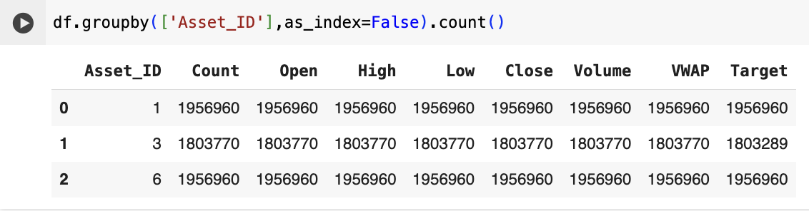
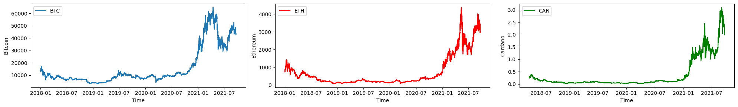
Number of Records
Figure 1: Number of records for each crypto
Each asset has different scale of pricing.
Figure 2: Price trend for each crypto
Notes:
Sampled data of latest 6 months of 2021
Each of them operating at different pricing level

Slide 5
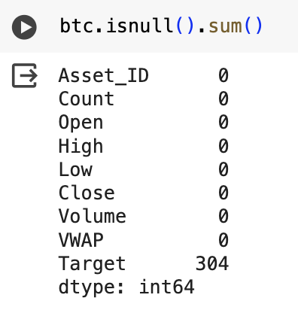
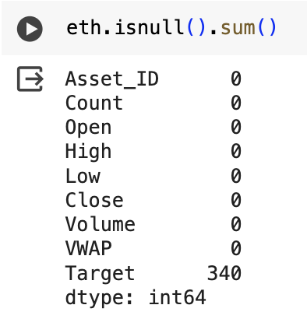
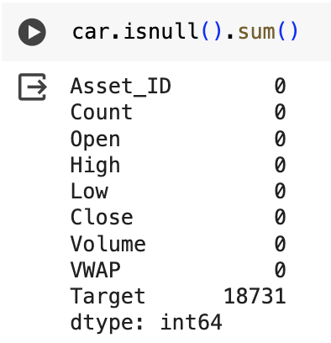
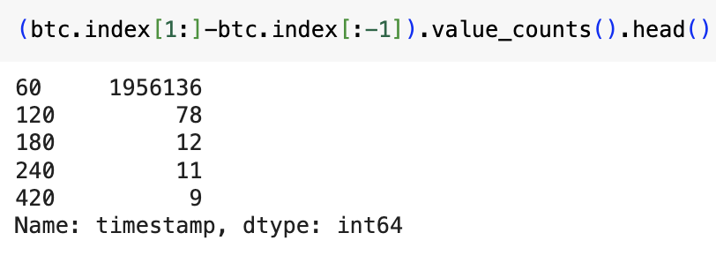
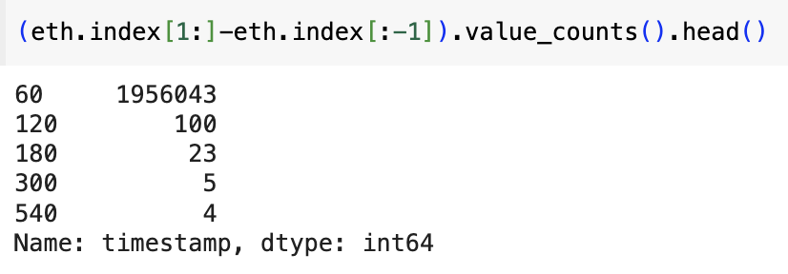
EDA (Exploratory Data Analysis)
Null Values
Figure 3: Nulls for Bitcoin
Figure 4: Nulls for Etherium
Figure 5: Nulls for Cardano
Missing Records
Figure 6: Gaps for Bitcoin
Figure 7: Gaps for Ethereum

Slide 6
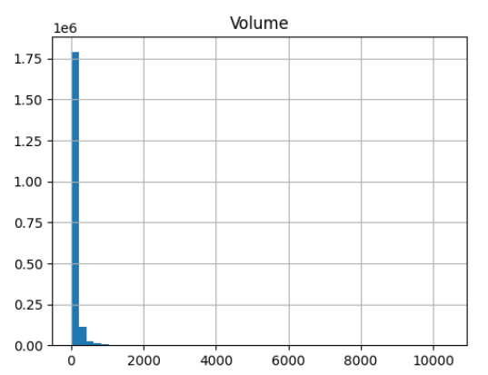
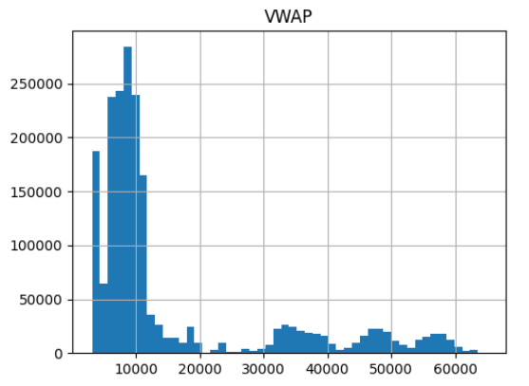
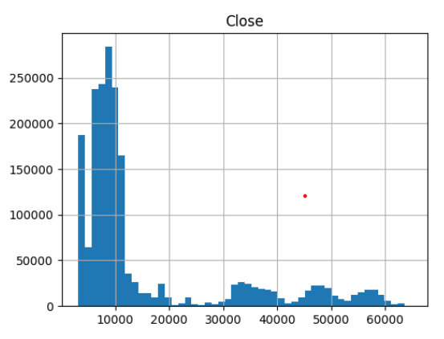
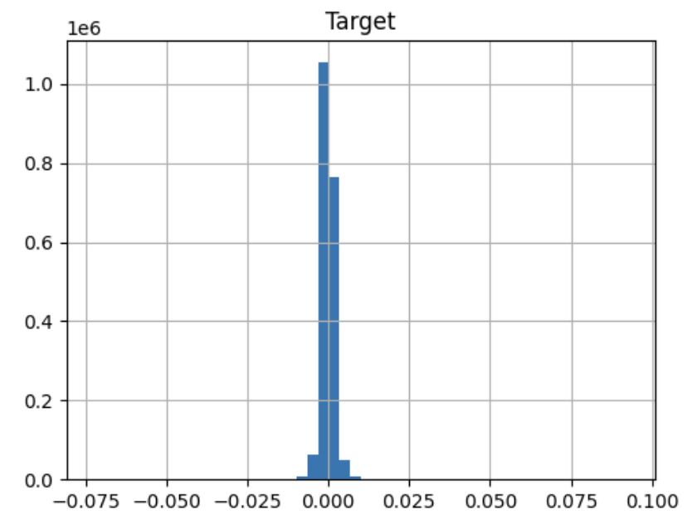
Data Distribution
Figure 8: Volume Distribution
Figure 9: VWAP Distribution
Figure 10: Close Distribution
Figure 11: Target Distribution
Notes:
Target is already normalized since its engineered variable

Slide 7
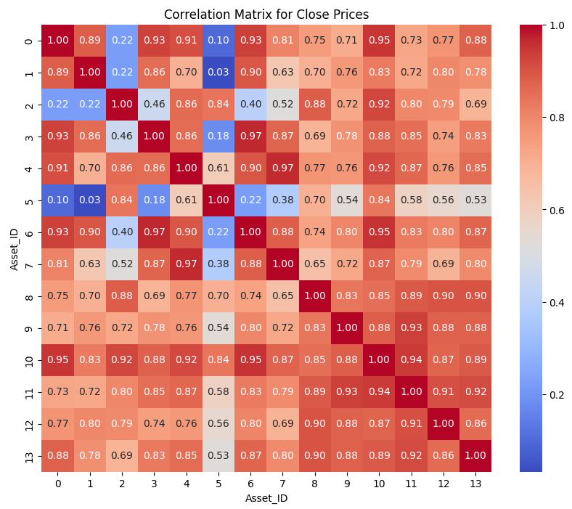
Correlation Matrix
Cardano
Weight: 4.4
Etherium
Weight: 5.8
Figure 12: Correlation matrix for Close Prices
Notes:
We’ve chose etherium and cardano based on weights but we also observed they’re highly correlated in price movements

Slide 8
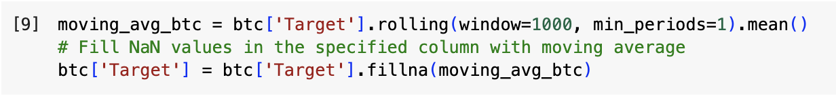
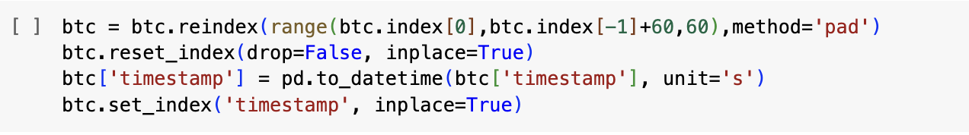
Data Pre-processing
Filling Null Values
Moving averages to fill null values in Target column
Figure 13: Code used for filling null values
Filling Gaps
Forward fill for imputation of missing records
Figure 14: Code used for filling gaps

Slide 9
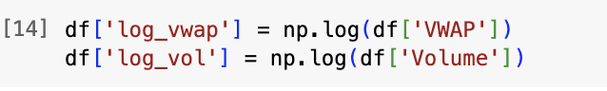
Log Transformation
Applied log transformation to columns VWAP and Volume to achieve normal distribution to help model generalize well
Figure 15: Code used for log transformation
Data Partition
Training | Validation | Test
70% | 20% | 10%
Table 3: Data partition split

Slide 10
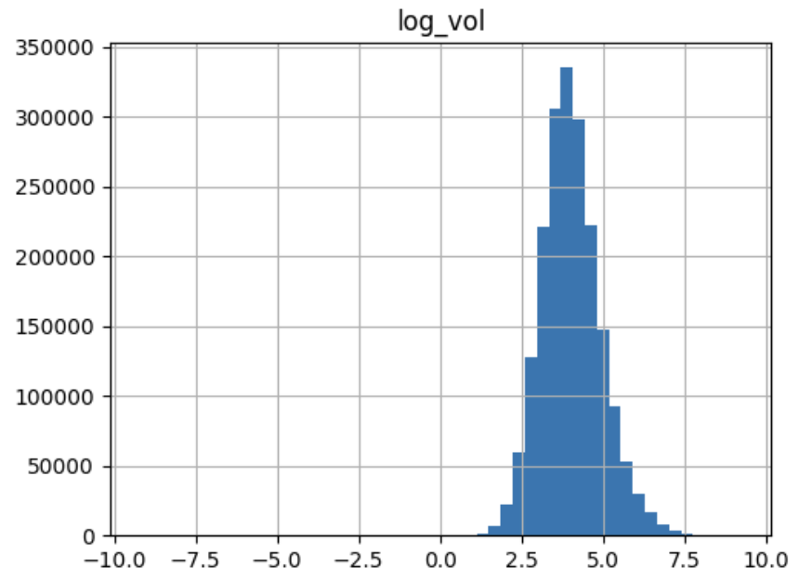
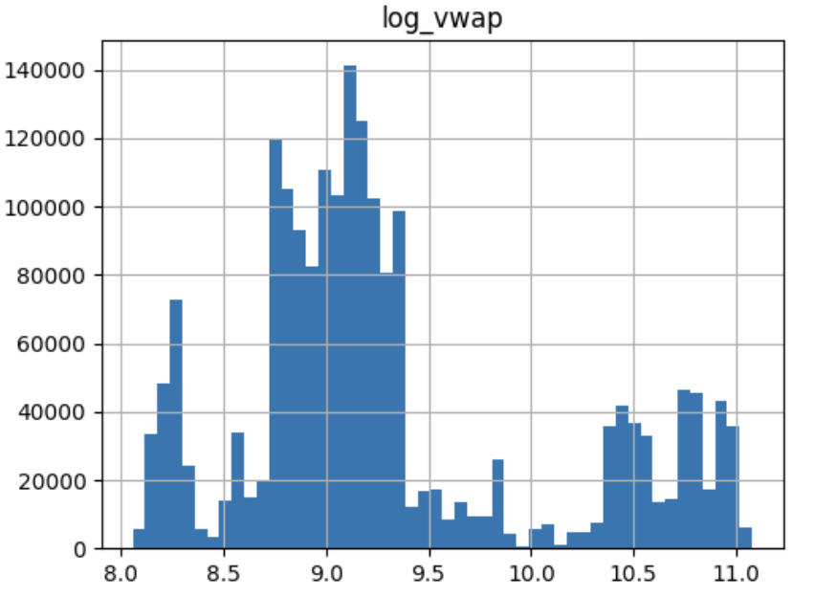
Log Transformation
Figure 16: Volume distribution before log transformation
Figure 17: Volume distribution after log transformation
Figure 18: VWAP distribution after log transformation
Figure 19: VWAP distribution after log transformation

Slide 11
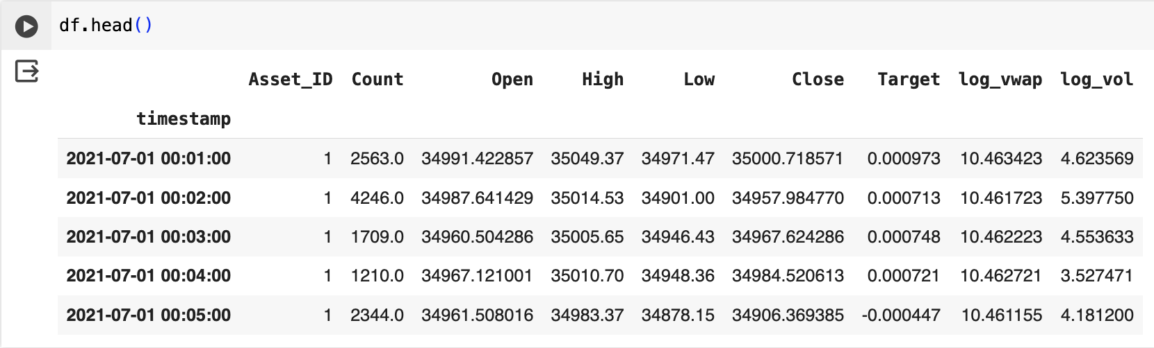
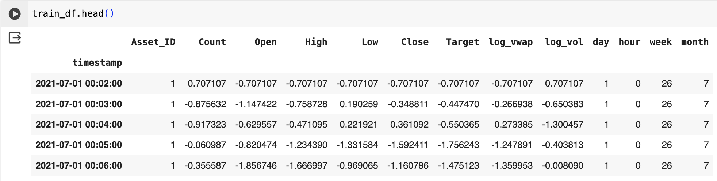
Temporal Decomposition
Added temporal features – day, hour, week & month to help model in generalizing patterns
Figure 20: Dataset before temporal decomposition
Figure 21: Dataset after temporal decomposition

Slide 12
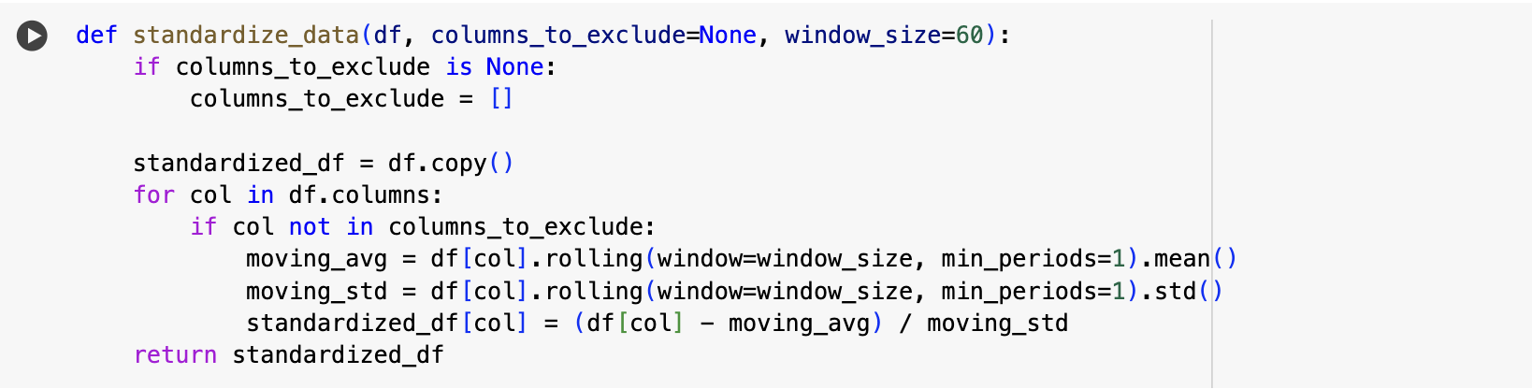
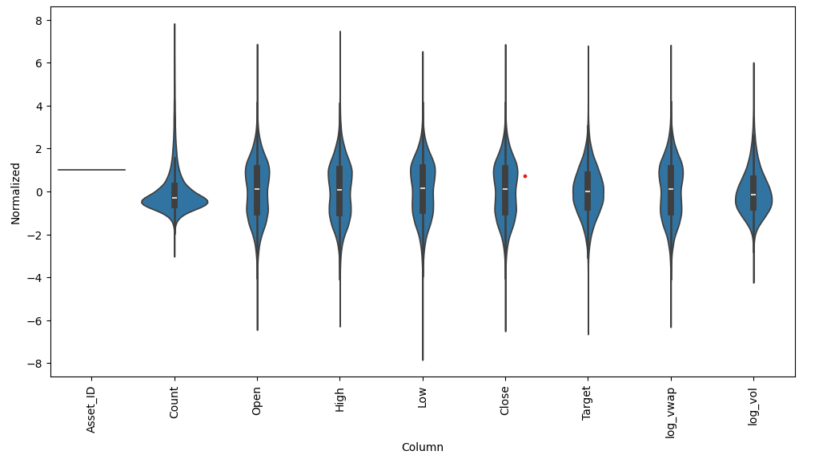
Standardization
Localized standardization using moving average and standard deviation to retain trends in locality
Figure 22: Code used for standardization
Figure 23: Standardization graph

Slide 13
Sequence Generation
t=0
t=1
t=2
t=..
t=59
t=60
Inputs
Model
t=1
t=2
t=3
t=..
t=60
t=61
Predictions
t=1
t=2
t=3
t=..
t=60
t=61
Labels

Slide 14
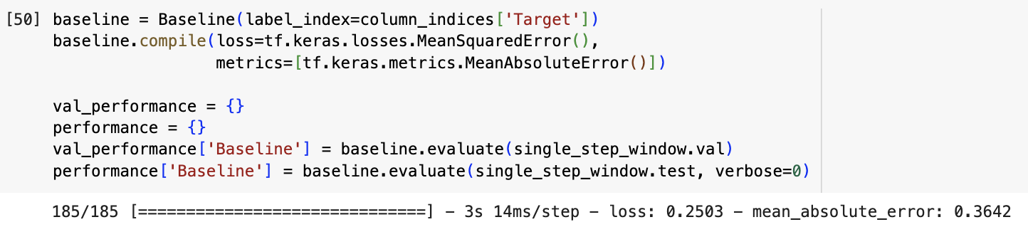
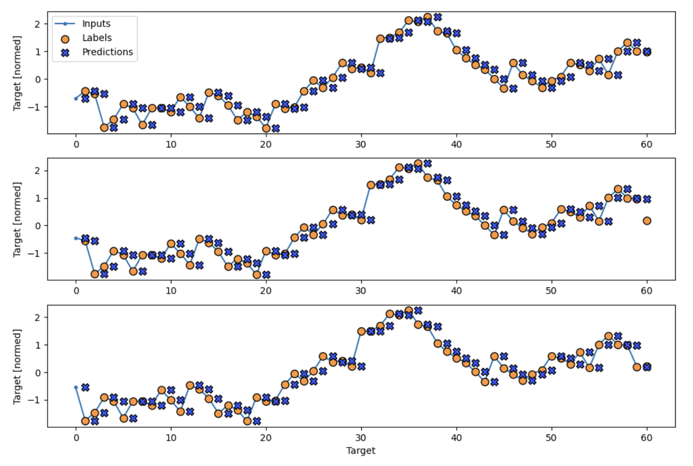
Modelling
Baseline Model
Figure 24: Code used for baseline model
Figure 25: Prediction samples

Slide 15
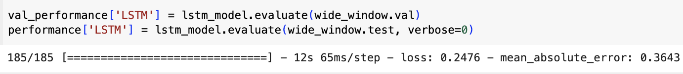
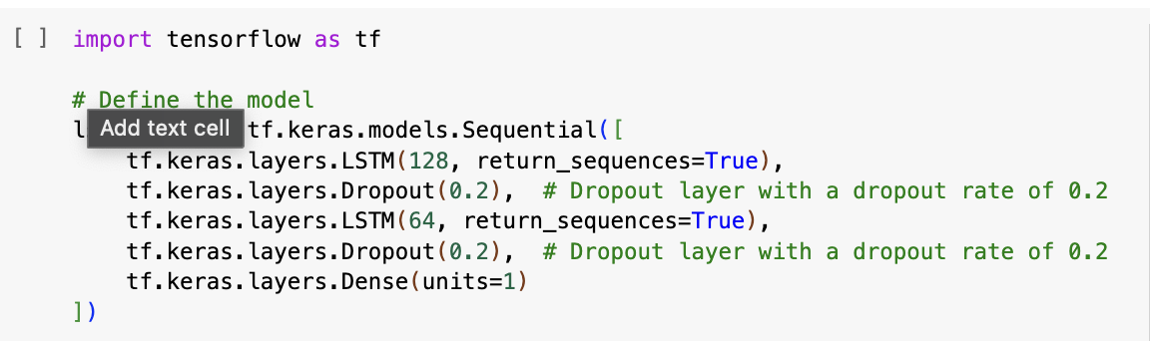
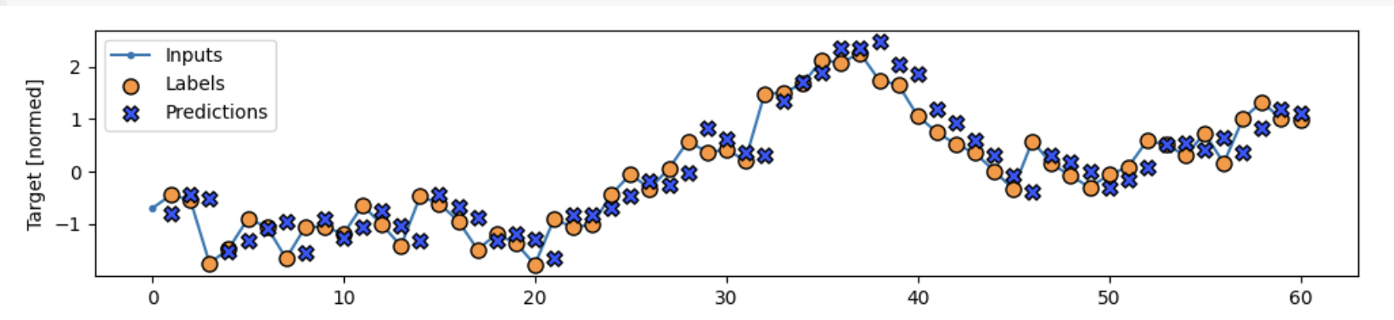
LSTM Model 1: Bitcoin
Figure 26: Model 1 validation metrics
Figure 27: LSTM Model
Figure 28: Sample Predictions

Slide 16
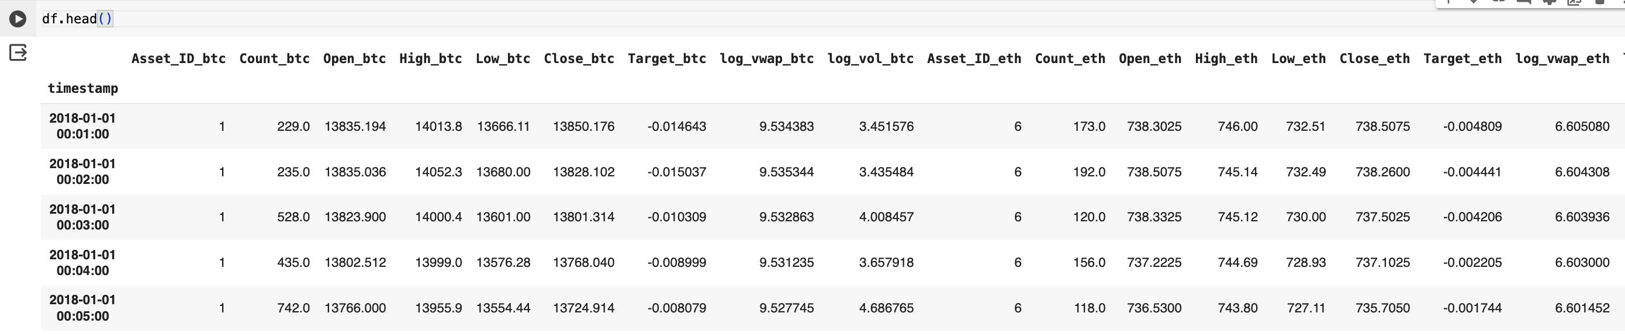
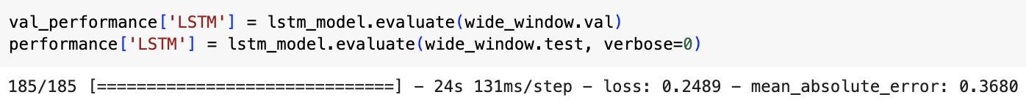
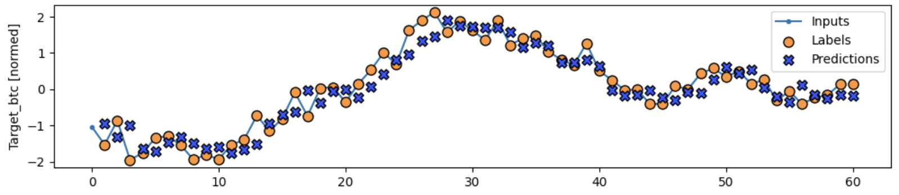
LSTM Model 2: Bitcoin + Ethereum
Figure 29: Input Data sample
Figure 30: Model 2 validation metrics
Figure 31: Prediction sample

Slide 17
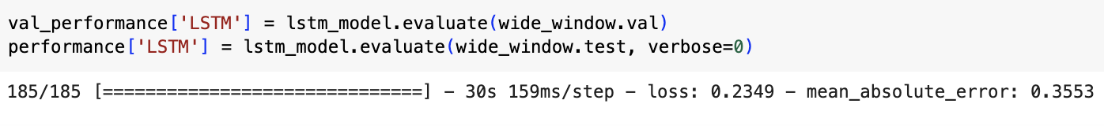
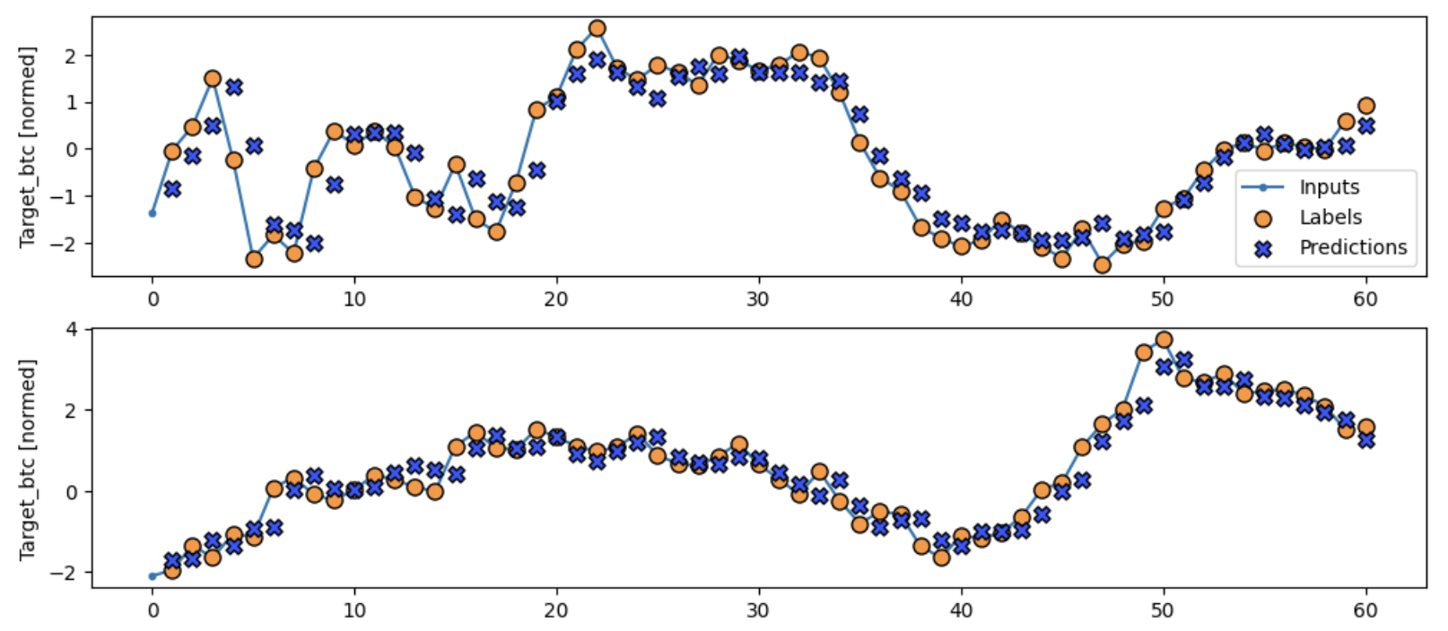
LSTM Model 3: Bitcoin + Ethereum + Cardano
Figure 32: Model 3 validation metrics
Figure 33: Prediction sample

Slide 18
Comparison
Model | MSE | MAE
Bitcoin | 0.2476 | 0.3643
Bitcoin + Ethereum | 0.2489 | 0.3680
Bitcoin + Ethereum + Cardano | 0.2349 | 0.3553
Table 4: Model comparison
Among all the three models, the model with three different crypto assets (Bitcoin + Ethereum + Cardano) has performed well compared to the other two models due to diversified nature of data.

Slide 19
Thank You

